Slide 1
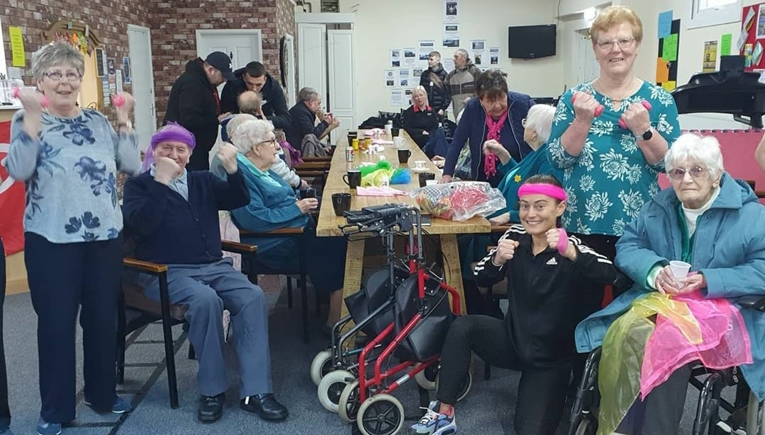
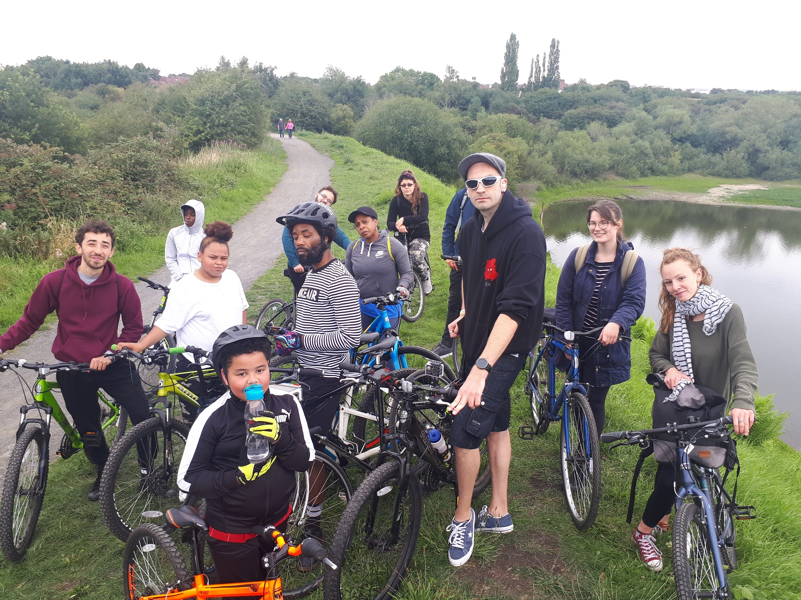
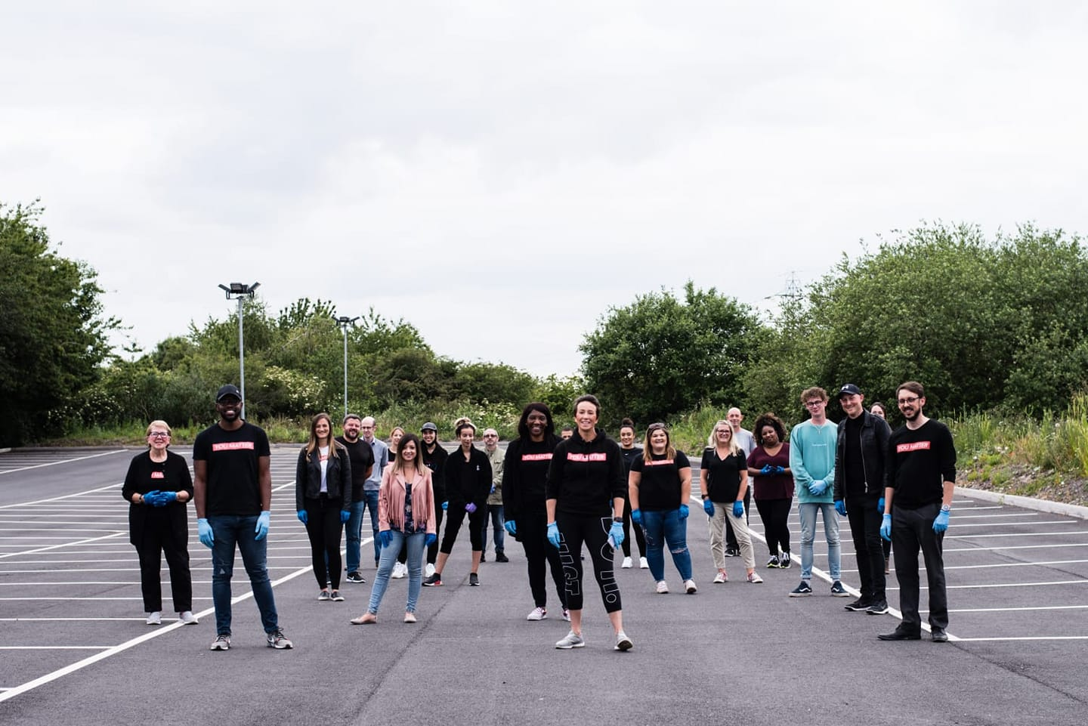
Cluster Connect bringing together residents and partners who care and are invested in the area to see collectively how we can bring about positive change that improves the lives of people who live there
I just wanted to say what fantastic work has been going on supporting vulnerable families and children during these difficult times. well done to all
Gail Hooper, Dudley School Nurse Team Leader
It’s all about local people!

Slide 2
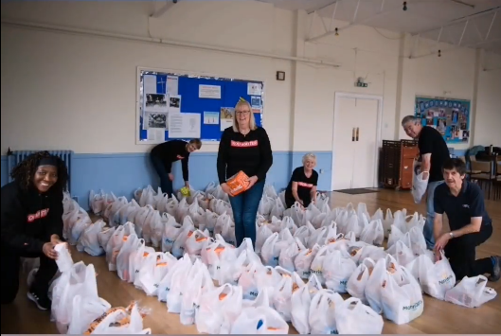
Cluster Connect
The Purpose / Aims
Based on the success of the pilot project in Dudley Central it was our aim to start to roll out the ethos, values and principles into other areas
Our aims between January and March were to
Establish understanding of the cluster connect approach in each area.
Identify VCF facilitator in each area who ‘gets it’, is committed and happy to lead on this for their cluster moving forward.
Identify elected members who would be actively involved and could support in each area
Identify Council Officers whose involvement is essential in each area
What are the current structure(s) informal or formal that enables local agencies and organisations to come together to work collaboratively to support children, young people and their families. What organisations, groups and agencies are involved. What are their aims and objectives? What has been achieved to date that we can build on?
What organisations or groups are currently delivering a joint up approach that could be involved
What relationships, links and partnerships do organisations and groups currently have with statutory partners?
What strong resident / community infrastructures are in place that ensure residents voices are heard in this work (for example Gornal has a really active Tenants and Residents)
What the Data is telling us for each area.
What are the priorities or issues emerging in each area both from the data and anecdotally on the ground.
Gather examples of strengths, successes and good collaborative working in each area that will be key to connect into this work (so for example the pom-poms for loneliness work in Coseley)

Slide 3
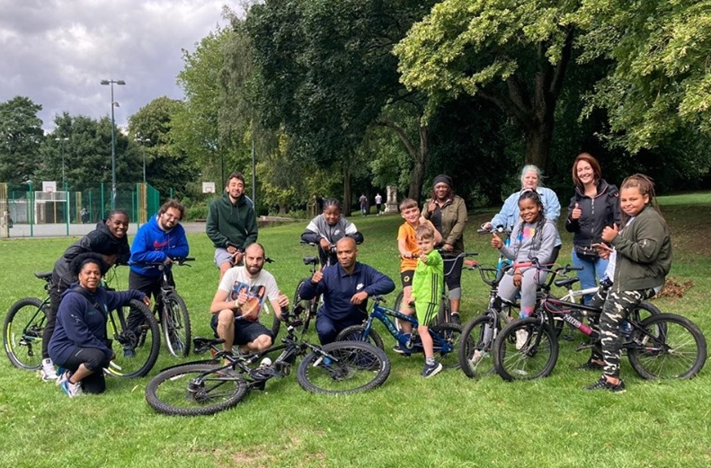
Do other areas want Cluster Connect?
Establish understanding of the cluster connect approach in each area, what are people’s views to this approach in their area, how do they think it would work or what may need to change for them.
The response has been overwhelmingly positive from all sectors in all areas!
There is an excitement around what we have achieved and the potential for their area
People in other cluster areas are asking members of the Dudley Central when it will happen in their area and how can they get involved
Dudley North is a complex area and may have a different approach, but that’s the beauty of cluster connect, its about what’s right for that area!
We are supported with extra help by other volunteers from the same community where we are working. They share their point of view with us and help us to understand the real needs that we have to focus on. It is good to see people participating to improve their community.
Angela Edwards, High Oak Youth and Community Group

Slide 4
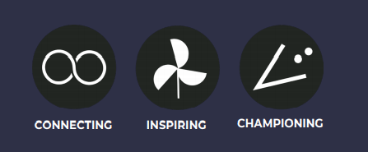
Facilitators?
What's their role?
Identify VCF facilitator in each area who ‘gets it’, is committed and happy to be supported by us but lead on this for their cluster moving forward.
It was always felt that the chair / facilitation role should sit outside of the LA and a Voluntary Sector organisation should lead on this
Someone who is passionate and connected with the area
Someone who has really good relationship with all sectors and the community
Someone who collaborates naturally and facilitates. A passionate relationship builder with the skills and values needed
Brierley Hill – Lauren from Top Church Training
Halesowen – Vicky from the Bid

Slide 5
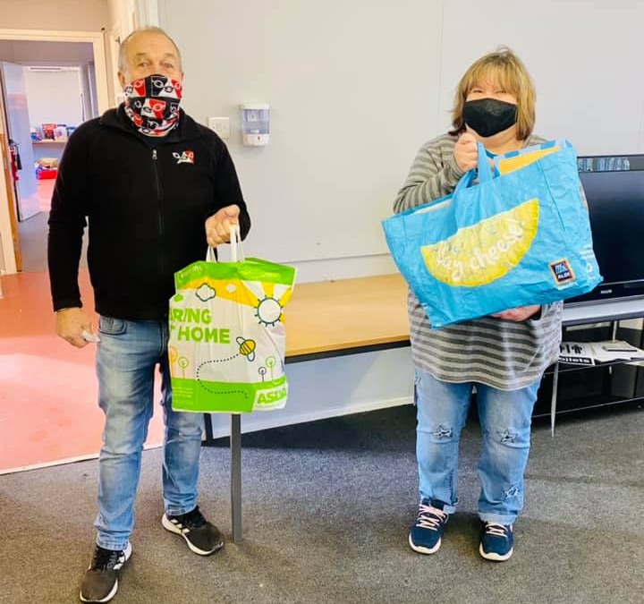
Elected member involvement…
Identify elected members / council officers who would be actively involved and could support in each area
Elected member have been involved in conversations in every area so far we have had conversations and involvement with
Cllr Nicholas Barlow
Cllr Anne Millward
Cllr Laura Taylor
Cllr Joe Roberts
Cllr Simon Phipps
Cllr Adam Aston
Cllr Sue Rydney
Cllr Kieran Casey
Cllr. Serena Craigie
Cllr. Ridha Ahmed
Cluster Connect has been a fantastic forum to find out about all the amazing work that all our organisations in Central Dudley are doing to support the community
Cllr Cathy Bayton

Slide 6
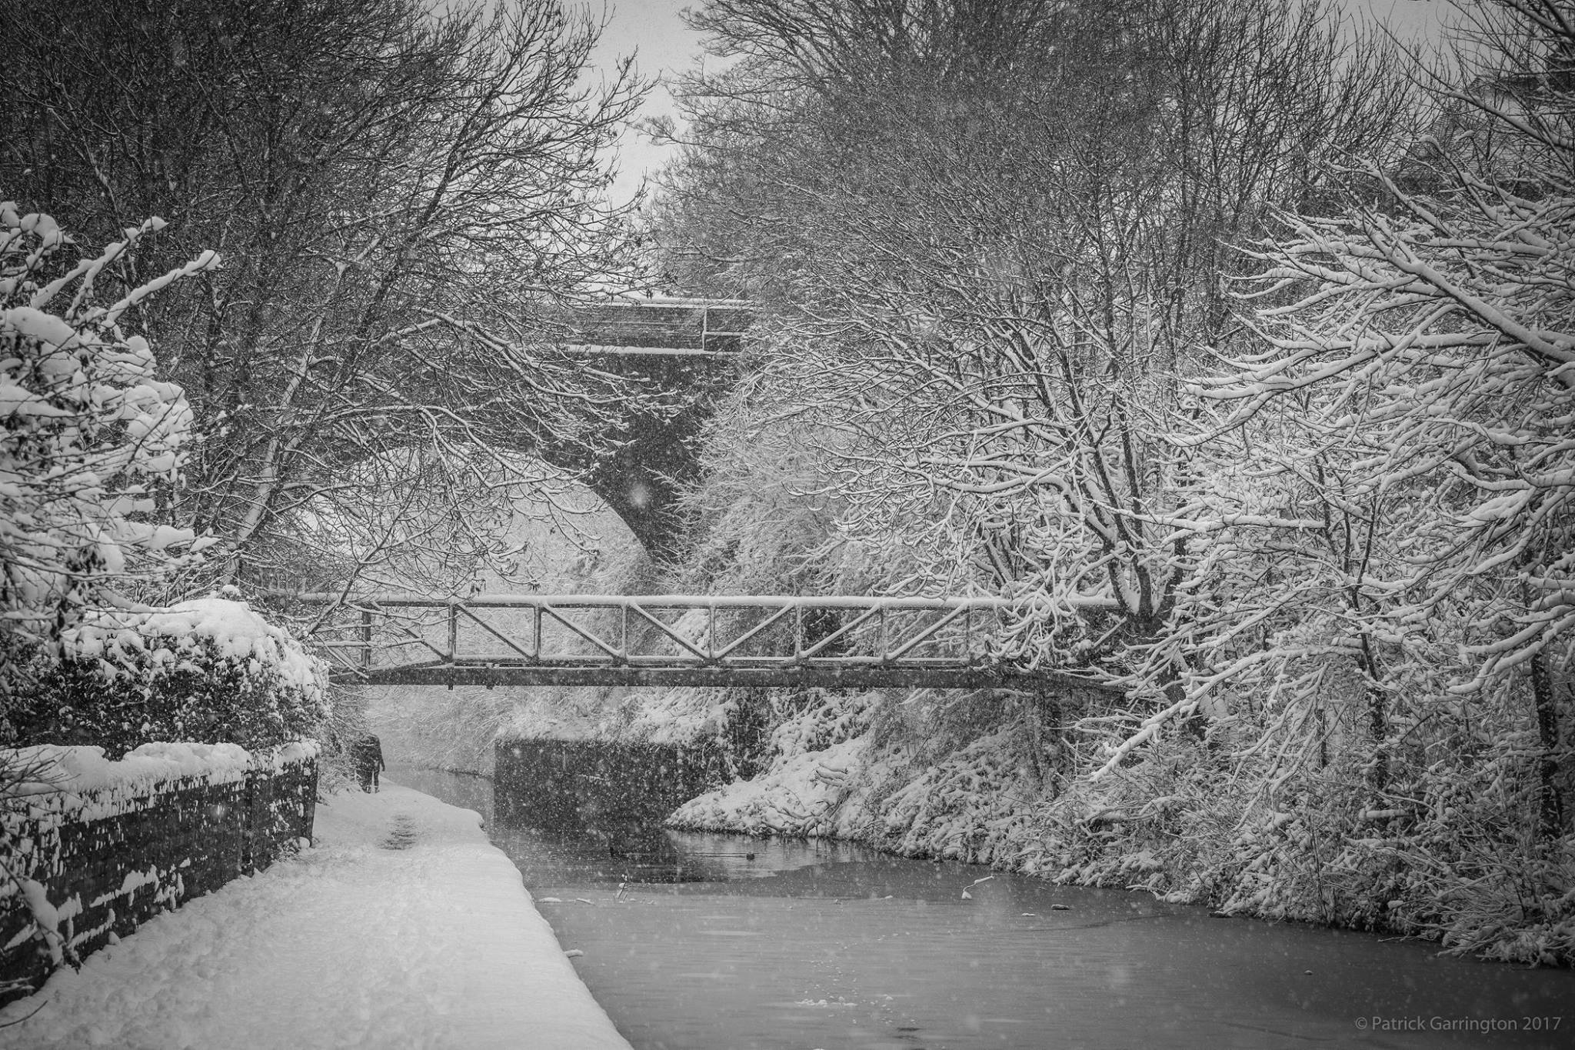
Current Networks …
What are the current structure(s) informal or formal that enables local agencies and organisations to come together to work collaboratively.
Residents and Tenants Associations
Faith Networks
Elected Members
Brierley Hill Forum
East Coseley Big Local
Halesowen Business Improvement District
Sedgley Past and Present
Sedgley Patient Participation group
Thanks for this mornings Cluster Connect Meeting. We have managed to move a few beans on and the baking items to two other organisations, how great is that! I also have very positive news about storage. We are partnering with Loaves and Fishes who are providing space for us. I love it when we can partner and support each other
Jen Coleman, CEO Black Country Food Bank

Slide 7
Local Groups and organisations
What organisations or groups are currently delivering a joint up approach that could be involved
Cluster Connect is a real positive initiative, it helps bring organisations together to see how we can tackle the key priorities for the area.
Aaron Laurence, Dudley MBC Community Development Worker
Black Country Wellbeing Centre
Hope House
Just Straight Talk
Upper Gornal Pentacostal church
Team Rector of the Parish of Gornal and Sedgley
Sedgley Friendship Group
Darkhouse Foodbank
Breathing Space
Friends of Abbey Street Park
Tenants and Resident Associations
Halas Homes
The Welcome Group
Asda community Champions
Halesowen Scouts
Lutley Community Centre
Hasbury Community Centre
Phase Trust
Brett Young Day Centre
Brierley Hill Market Traders
Brierley Hill Forum
Top Church Training
Hawbush Community Gardens
Brierley Hill Baby Bank
The Brierley Hill Project
Riverside House
Residents

Slide 8
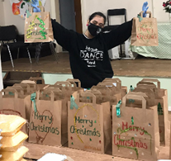
Statutory Partners…
SO far we have involved
Police and PCSO’s
Integrated Plus Officers
Family Centre Staff
Community Development Workers
Primary and Secondary Schools
Elected Members
Kingswinford Medical Practice
CCG / DIHC
“So appreciate the volunteers in the soup kitchen. The commitment of their time and varied food preparation under these circumstances to the community is great; and they always deliver with a smile.”
A beneficiary of the project

Slide 9
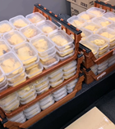
What's the data telling us?
What the Data is telling us for each area…
Dudley North has a much older population in some parts of Gornal and Sedgley more than a third of the population is 65 or older
Dudley North and Stourbridge townships both have a relatively small proportion of their populations in the 0-19 age group (22.3% in each case).
Dudley North has the smallest working age population of any of the five townships (less than 60% of the total population).
Dudley’s young Black and Minority Ethnic population was concentrated in the Dudley Central and Halesowen townships, where this group represents 29.1% and 20.5% of the population under 25 respectively.
Dudley North township had the lowest proportion of BME residents and the highest proportion of residents born in the UK (97.6%)
The largest concentration of those people identifying themselves as Gypsy/Irish Traveller were in Brierley Hill township, accounting for nearly a third of the total Dudley Gypsy/Irish traveller population.
Brierley Hill also had a large workday population - nearly 70,000
Stourbridge Township had the lowest proportion of residents with a religion at 70.9%, whilst Dudley North had the highest at 74.2%.
Stourbridge has the lowest proportion of households with dependent children with 27.6%.
Stourbridge had the lowest percentage of residents with no qualifications
For the male population in Dudley the ward with the highest life expectancy is Halesowen South. For the female population Kingswinford South has the highest life expectancy. The lowest age expectancy for females is found in Brockmoor and Pensnett.

Slide 10

What Priorities are emerging? dudleyconnect.com
What are the priorities or issues emerging in each area?
Dudley North – Loneliness and isolation (Loss, bereavement and an offer for young people) more community activity, Poverty (lacking attitudes)
Brierley Hill – Crime (Perception & actual), Poverty (Low income, low aspirations, low attainment), Building up the reputation of the town and people / decline of the high street
Halesowen – Loneliness and isolation, mental health, crime & ASB
Stourbridge – The effects of Covid-19 – job losses, furlough, making ends meet, loneliness and isolation, people not knowing what support is available.
(These are preliminary findings for Halesowen and Stourbridge)
Cluster Connect is great for the people of Dudley because they can find out what's available through the website, it’s such a thoughtful idea to support those who need the most help
Jen Coleman, CEO Black Country Food Bank

Slide 11
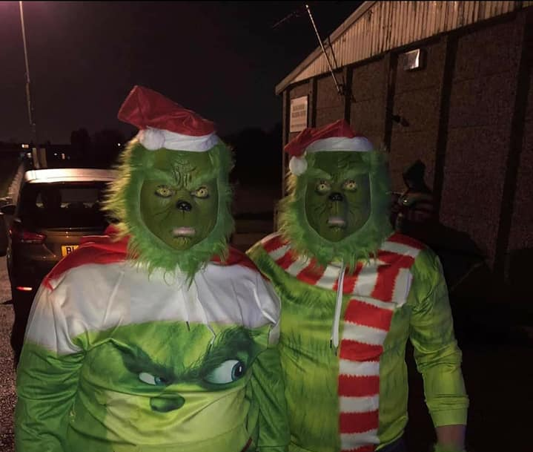
What are the Strengths?
Dudley North – Strong community spirit and strong networks, Community ties and pride in shared history, Strong faith networks
“We have community groups that work together and share ideas. We have friends and neighbours who help each other. There is a strong community spirit”
Brierley Hill – Positive community spirit, history and heritage, canals and green spaces.
“Passion for the town - compassion for each other, there is a sense of community. People support each other and those who don't have a lot will give to others in need”
Halesowen – There is lots of support and activity, a strong VCFs offer, lots of green space, connectivity
“Halesowen is a community were people want to get out and connect with others”
Stourbridge – communities are resilient and self sufficient, It has its own identity and people are proud of this, neighbourliness
“There is really pride in Stourbridge, it has its own identity, its independent, people are independently minded, they are not afraid to speak their minds”

Slide 12
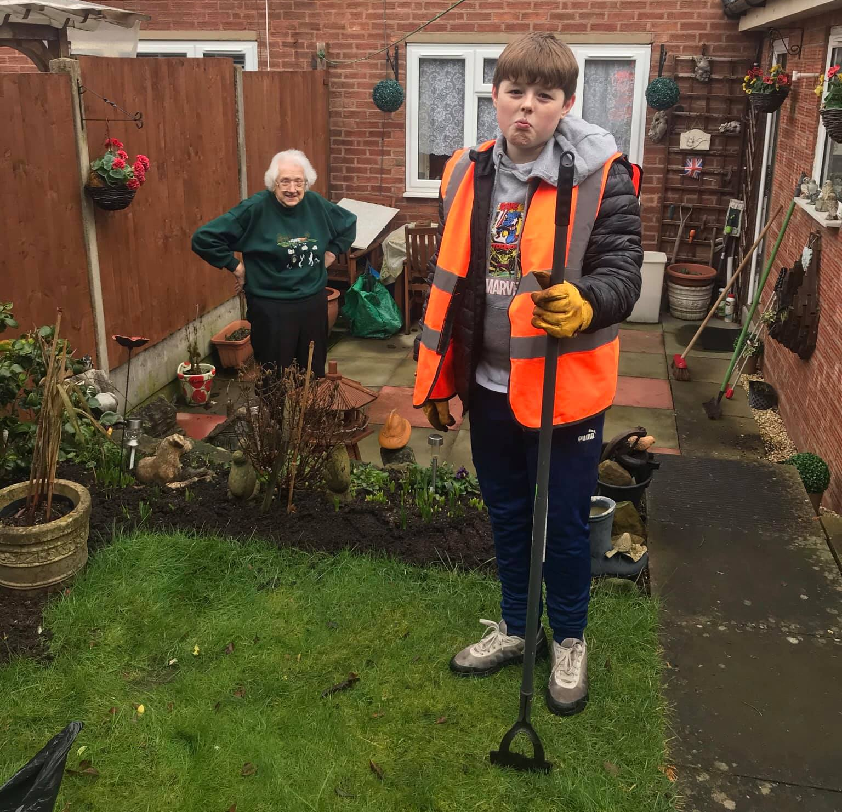
Future wishes
Dudley North – More opportunities to come together – social activities, more services particularly around mental health and grief and bereavement
“More services that can be provided the better, Intergenerational projects that helps people better understand each other”
Brierley Hill – Increase prosperity within the town, give local people a voice and the confidence to use it, share positive stories.
“Build aspirations amongst all, share more positive views of whats happening in Brierely Hill and share the stories of people making it happen.”
Halesowen – Build capacity for more peer to peer support, people would feel less lonely, people feel safer
“sometimes all people need is someone to hold there hand, to help build there confidence, these small actions can change lives”
Stourbridge – better signposting and information, doing with not to, maintain a sense of identity and belonging, more community events
“We need to nurture and encourage people to get out and engage, build stronger networks, develop things led by residents”

Slide 13
Learning…
The ethos, values and placed based working development principles have been key to the success
To replicate, it has to be developed organically within the structures that already exist locally
It is imperative to commence with conversations with a range of partners and conduct the Appreciative Inquiries to ensure people feel valued and included from the start
To include an elected member is an advantage when needing to un block
The early success of Cluster Connect has sparked the interest of the LA in a way that we have not seen before. It has gathered momentum and translated into a strategic direction to Family Centres to support the roll out this out borough wide
Being part of Cluster Connect has been fantastic, we've been able to meet all the other great organisations working in the area, find out what they are doing and collaborate with them using our own individual strengths.
Matt, Champions Church

Slide 14
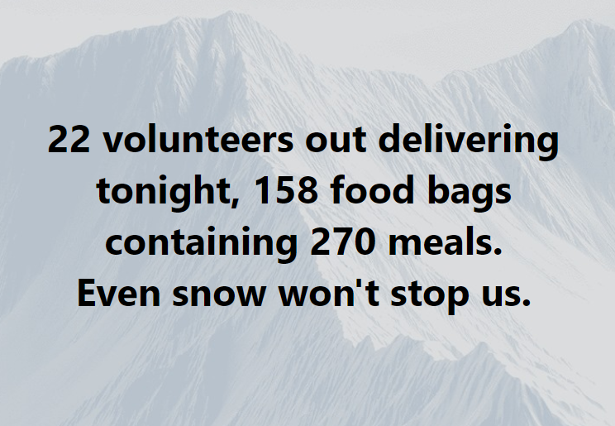
Challenges…
Our towns and villages are unique, always respect that and never forget it!
An issue such as Loneliness or Poverty is a big issue to solve and will take a lot of time
It’s a really long process, it’s a journey, don’t try to rush it!
Convincing others not to work with the preconceived idea as to how this would work (not using traditional methods)
I'm really impressed at how partners have been co-producing and utilising local assets through Cluster Connect.
Julia Simmonds, Dudley MBC Service Manager, Strategic Partnerships

Slide 15





Successes…
Pretty Edible Pots – through these Cluster Connect conversations we stumbled upon a brilliant idea to have a borough full of edible pots and hanging baskets! we have connected a variety of organisations across the borough and through the HAF funding we will be collaboratively delivering this project to over 1000 children, young people and families. One organisation is ordering the seeds, one organisation is doing an online tutorial, one is setting up the social media ~PEP!
Working in this way not only provides more understanding and connectivity in local areas it has the potential to increase understanding and connectivity right across the borough and enable us to have vibrant, exciting, beautiful projects.
Pretty Edible Pots

